Slide 1
UltraLite Coding: Banqi
Nicholas Walter
Tyler Hogenson
Spencer Lofing
Ben Finnerty
Max Maier

Slide 2
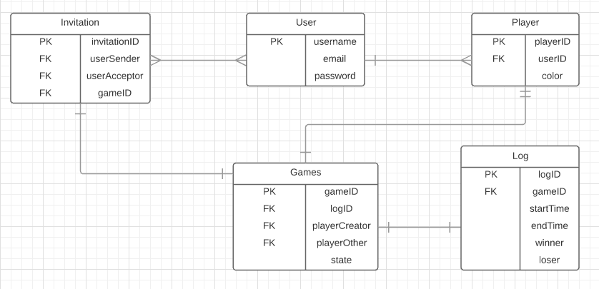
Entity Relationship diagram

Slide 3
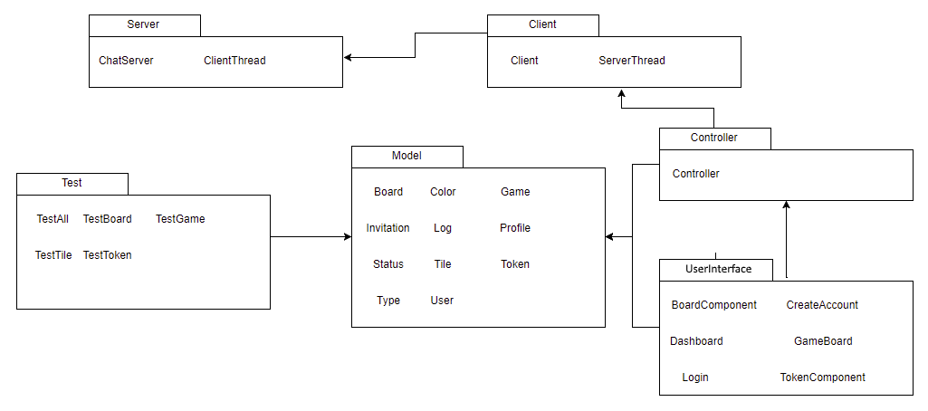
Package Diagram

Slide 4
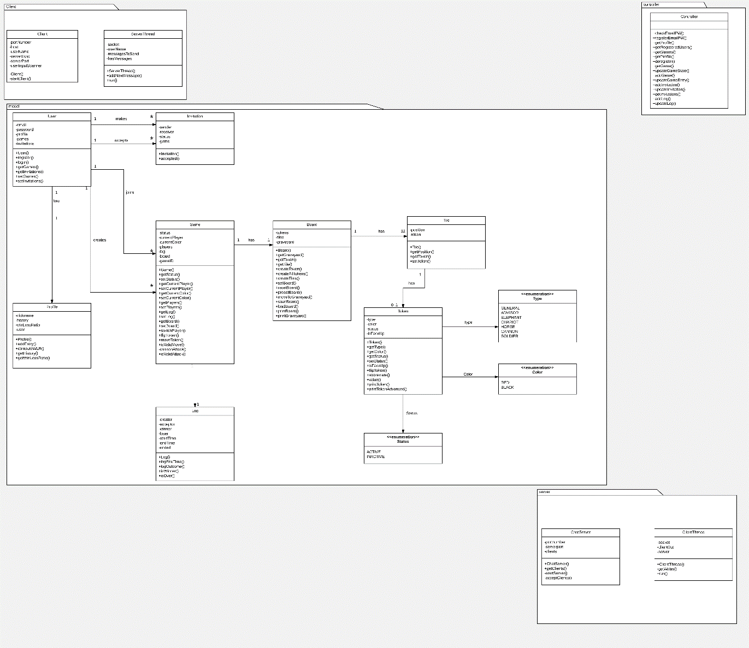
Updated Design Class Diagram, Overview

Slide 5
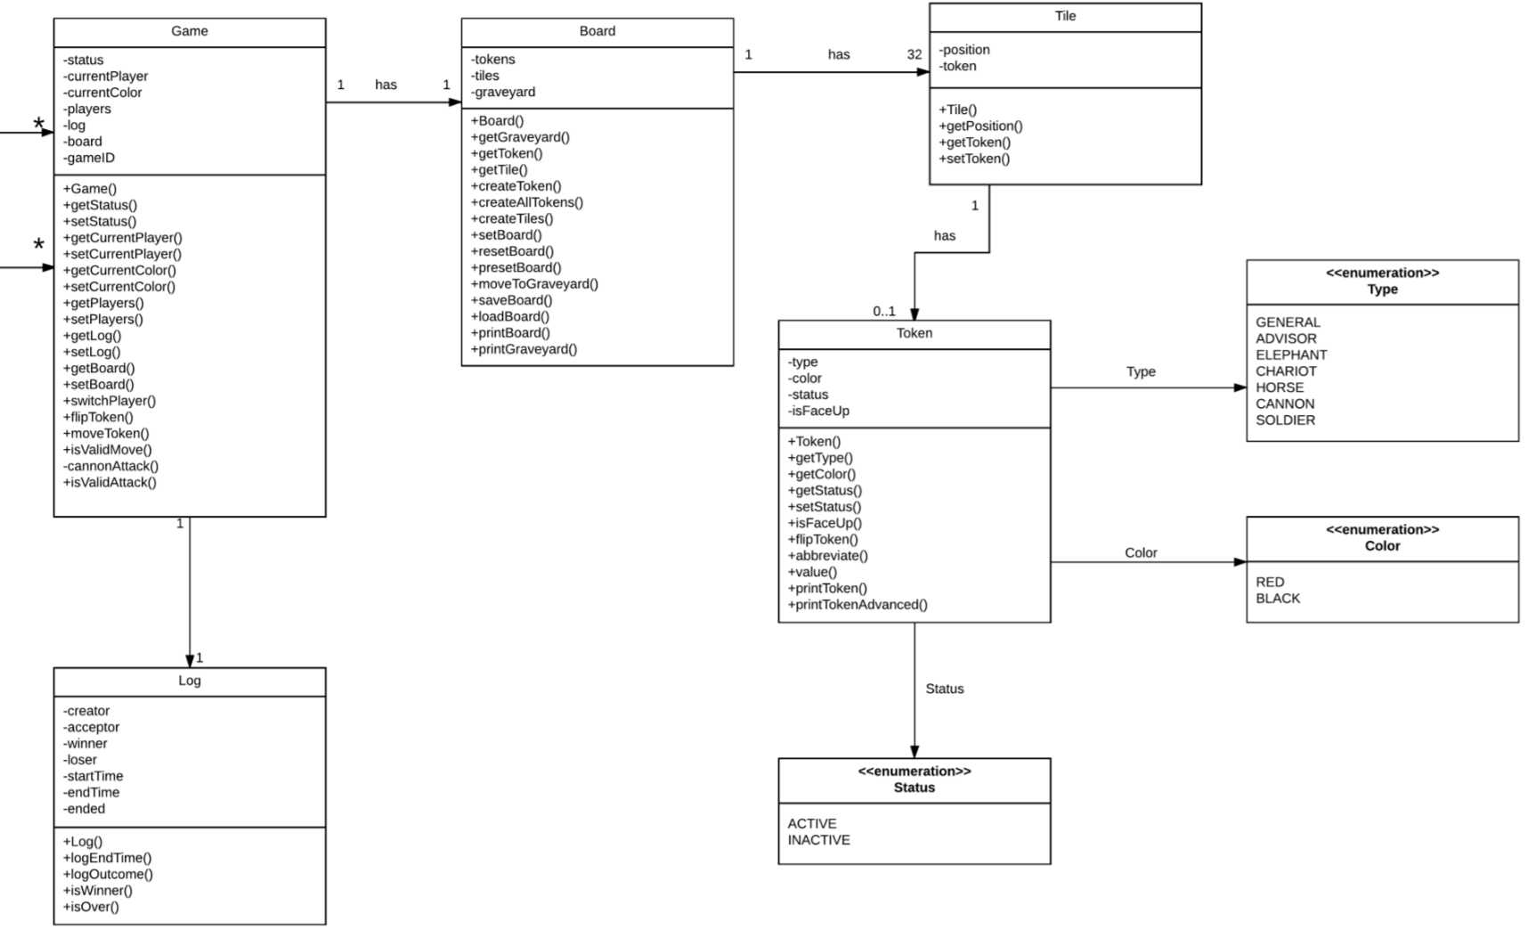

Slide 6
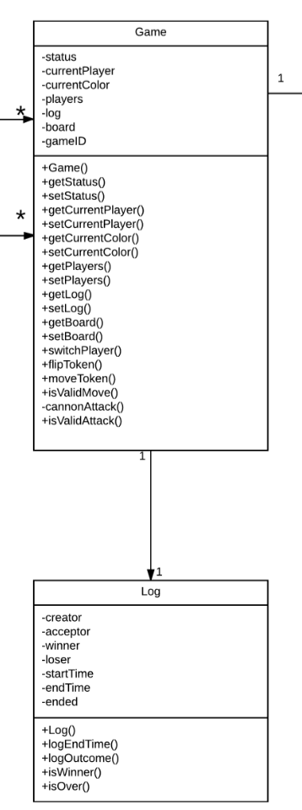
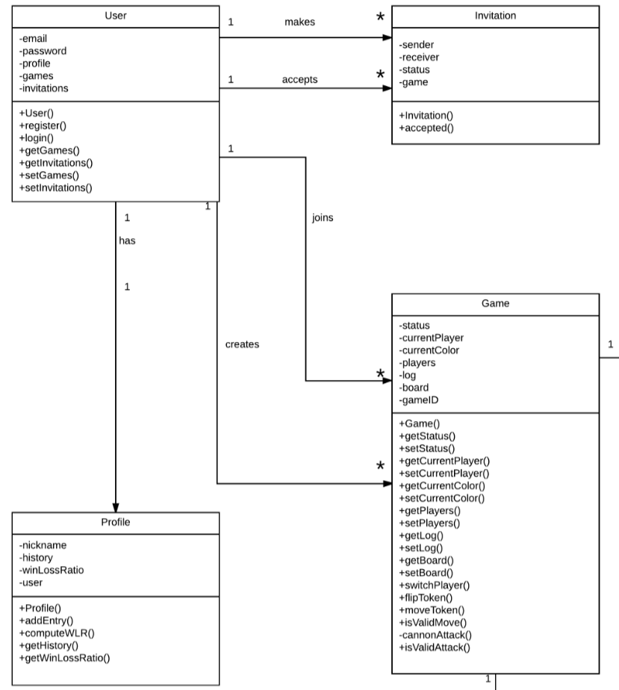

Slide 7
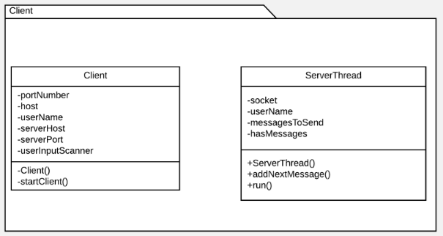
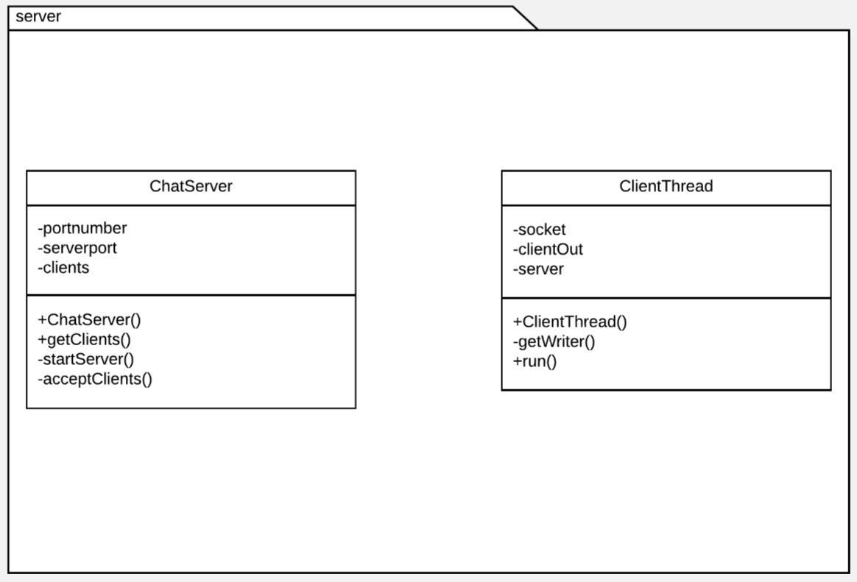
Client & Server

Slide 8
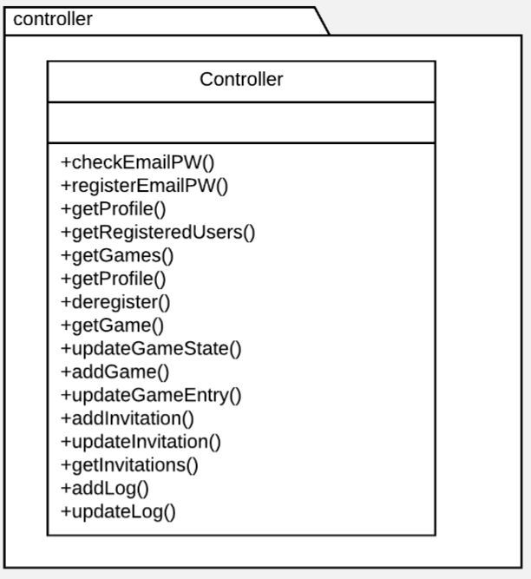
Controller

Slide 9
Refactoring and Design pattern list
Separated classes into Model-View-Controller packages
Implemented Façade Pattern by creating a few other packages
Used Extraction to reduce reuse of code within classes
Rearranged classes to have Low Coupling

Slide 10
Traceability Link Matrix

Slide 11
DEMO

